Slide 1

COS1512 – Online Class Session – 20 APRIL 2026
COS1512 – INTRODUCTION TO PROGRAMMING II – Using C++
Academic Year: 2026
Date: 20 APRIL 2026
Time: 17:00 PM to 19:00 PM

Slide 2
Chapter 2
Chapter 2

Slide 3
Chapter 2 C++ Programming Basics
Variables and Assignment
Data Types
Variables
Names: Identifiers
Variable Declarations
Assignment Statements
Input and Output
Standard input / output
Input / output streams

Slide 4
Variables and Assignment
Variables and Assignment
This chapter introduces the basics of C++.

Slide 5
Data Types
The objective of a C++ program is to manipulate data.
Example of Data: E-Commerce Customer Table
Customer ID | Full Name | Gender | Email Address | Date of Birth | Is Active | Account Balance
A101 | Jane Doe | F | jane@example.com | 1992-05-14 | True | 150.50
A102 | John Smith | M | john.s@web.com | 1985-11-30 | False | 20.00
Data Type
String | String | Char | String | Date | Boolean | Decimal / Float / Double

Slide 6
Data Types
Integral Types
represent whole numbers and their negatives
declared as int, short, or long
int num = 32;
Character Types
represent single characters
declared as char
char myChar = ‘A’;
Boolean Type
declared as a bool
has only 2 values true/false
bool isRaining = true;
Floating Types
represent real numbers with a decimal point
declared as float, or double
float pi = 3.14159;

Slide 7
Data Types
Integral Types
represent whole numbers and their negatives
declared as int, short, or long.
A comma cannot be used within an integer. Commas are only used for separating items in a list
int num = 32;
Character Types
represent single characters
declared as char. It is used for single characters: letters, digits, and special symbols
Each character is enclosed in single quotes. Eg., ‘M’, ‘F’, ‘0’, ‘+’, ‘*’, ‘$’, ‘&’
A blank space is a character written ' ', with a space left between the single quotes.
char myChar = ‘A’;
Different character data sets exist
ASCII: American Standard Code for Information Interchange.
Each of 128 values in ASCII code set represents a different character.
Characters have a predefined ordering based on the ASCII numeric value.

Slide 8
Data Types
Boolean Type
declared as a bool
has only two (2) values true/false. Purpose: to manipulate logical (Boolean) expressions
bool isRaining = true;
Floating Types
represent real numbers with a decimal point declared as float, or double.
Float point range: four bytes
Double range: eight bytes
float pi = 3.14159;

Slide 9
Variables
A variable is a named storage location in memory used to hold data.
Key points:
Declaring a variable means specifying both its name and its data type.
It holds a piece of data.
The data that it holds may change while the program is running.
The name of the variable should describe its purpose to make the code more readable and maintainable.
A variable must be defined (declared) before it can be used.
Example variable definition:
double salary; // stores decimal numbers (e.g., 3.14)
int age; // stores whole numbers (e.g., 25)
Char grade; // stores a single character (e.g., ‘A’)
Data types specify the kind of data a variable can hold (e.g., integers, floating-point numbers, characters).

Slide 10
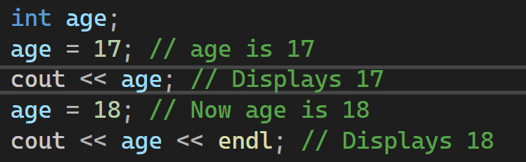
Variables and Their Values
When a new value is stored in the variable, it replaces the previous value
The previous value is overwritten and can no longer be retrieved
unless it is stored elsewhere (like in another variable or before the change).
int age = 25; (initial value)
int previous
Age = age; (store the previous value before changing it)
age = 30; (change the value of age)
You will be able to access previous
Age to retrieve the old value, even though age was overwritten

Slide 11
Names: Identifiers
An identifier is just a name we give to variables, functions, constants, types, or any element we want to refer to in a C++ program.
Identifiers should be descriptive
Using meaningful identifiers is a good programming practice
Makes your code easier to understand
Instead of int x = 5;
Better use: int age = 5;
double studentAverage
C++ is a case-sensitive language.
Work is not work:
int work = 10;
int Work = 20;
Compiler treats them as completely different identifiers

Slide 12
Rules for Naming Identifiers
Names: Identifiers
Must be unique
Cannot be reserved words (keywords)
double, main, return
Must start with a letter or underscore (no spaces or special symbols)
can be followed by zero or more letters (A-Z, a-z), digits (0-9), or underscores
Valid Identifiers
age_of_dog
_taxRateY2K
PrintHeading
ageOfHorse
Invalid Indentifiers
age# (invalid character #)
2000TaxRate (starts with a digit)
Age-Of-Dog (hyphens are not allowed)
main (reserved keyword)

Slide 13
Variable Declarations
Variable Declarations:
In C++, variables must be declared before they are used.
Syntax for Declaring Multiple Variables:
Commas are used to separate multiple identifiers of the same type.
dataType identifier;
For example, consider the following statements:
int counter;
double interestRate;
char grade;
int count, age; (both count and age are declared as integers)
Initialization During Declaration:
Variables can be initialized to a starting value when they are declared
int count = 0; (count is initialized to 0)
You can also declare multiple variables and initialize only some of them:
int age, count = 0; (age is declared but not initialized, count is initialized to 0)

Slide 14
Assignment Statements
Assignment Statements
An assignment statement is an order to the computer saying, “set the value of this variable to what I have written down.”
One way to store a value in a variable is by using an assignment statement, which
takes the following form:
variable = expression;
where expression is evaluated and its value is assigned to variable. In C++, = is
called the assignment operator.
For example, consider the following statements:
counter = 5;
interestRate = 0.05;
grade = 'A’;
totalWeight = oneWeight * numberOfBars;

Slide 15
Input / Output Streams and Devices
Input / Output Streams and Devices
An input stream is simply the stream of input that is being fed into the computer for the program to use.
A program can read input from the keyboard (e.g., from a command prompt / shell). <iostream>
A program can read its input from a file. <fstream>
An output stream is the stream of output generated by the program (e.g., to a monitor / command prompt / file).

Slide 16
Standard Input / Output
Input Using cin (and the Extraction Operator >>)
Output Using cout (and the insertion operator)
Include Directives and Namespaces
Escape Sequences (\)

Slide 17
Standard Input / Output
Input Using cin (and the Extraction Operator >>)
The variable cin has access to operators and functions that can be used to extract data from the standard input device. We use the extraction operator >> to input data from the standard input device.
Output Using cout
The arrow notation << is often called the insertion operator. The entire cout statement ends with a semicolon.

Slide 18
Standard Input / Output
Include Preprocessing Directives (Libraries) and Namespaces
Many functions and symbols needed to run a C++ program are provided as collection of libraries.
Every library has a name and is referred to by a header file.
Preprocessor directives are processed by the preprocessor program.
All preprocessor commands begin with #
Preprocessor commands are processed before the program goes through the compiler
E.g.,
#include <iostream>
#include <fstream>
#include <cmatch>
#include <string>
using namespace std; vs std::
cin and cout are declared in the header file iostream, but within std namespace

Slide 19
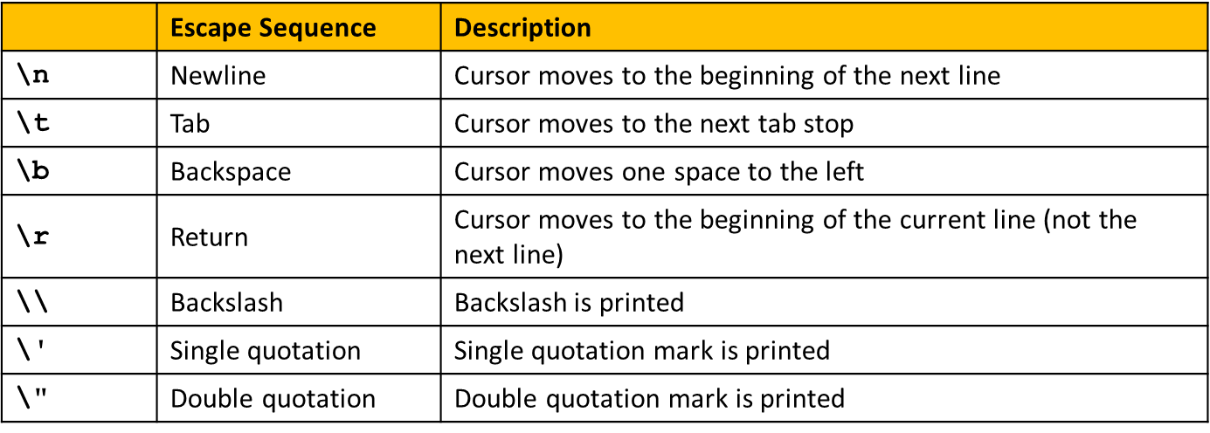
Standard Input / Output
Escape Sequences (\)
The backslash, \, preceding a character tells the compiler that the character following the \ does not have the same meaning as the character appearing by itself. Such a sequence is called an escape sequence. A sequence is typed in as two characters with no space between the symbols.
E.g.,

Slide 20
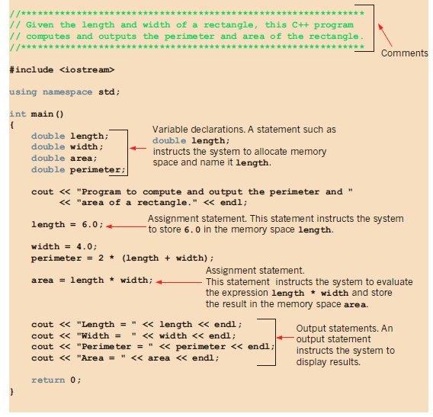
First C++ Program
Different parts of a C++ Program

Slide 21


First C++ Program
Memory locations
Eessentially, a variable is a memory location whose contents can be changed. So, length, width, area, and perimeter are variables.
During program execution, the system will allocate four memory locations to store decimal numbers, and those memory locations will be named length, width, area, and perimeter, respectively.
The statement length = 6.0; will cause the system to store 6.0 in the memory location associated with the name (or identified by the name) length.

Slide 22
Flow of Control (Next Class Session)
Three processes a computer can do:
Sequential
is the simplest flow of control
It involves executing instructions one after the other, in order, from start to finish.
It is a linear process where each step follows the previous one.
e.g. expressions, insertion and extraction operations
Selection (Branching)
Selection allows a program to make decisions based on conditions.
Depending on whether a condition is true or false, different code paths are executed.
e.g. if statement, switch statement
Repetition/Iteration (Loop)
Repetition or iteration allows a program to execute a block of code repeatedly.
Loops are used when you want to perform the same task multiple times.
e.g. while loop, do-while loop, for loop

